Slide 1
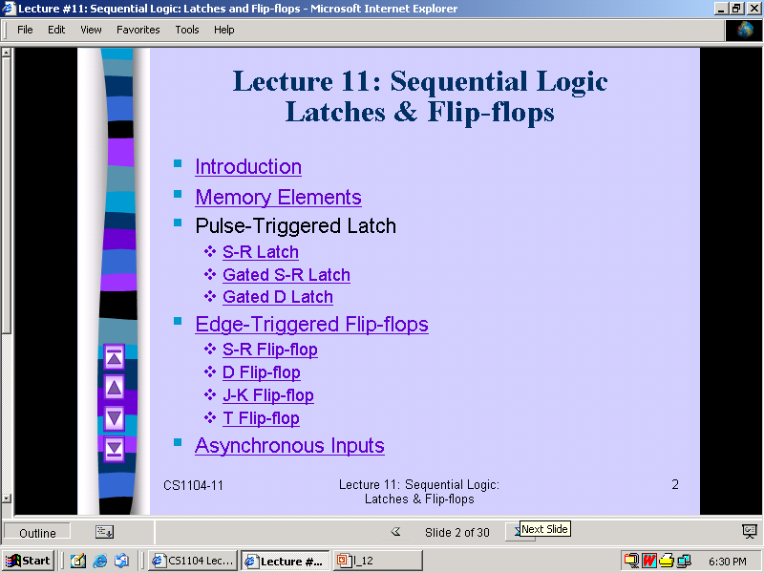

Slide 2
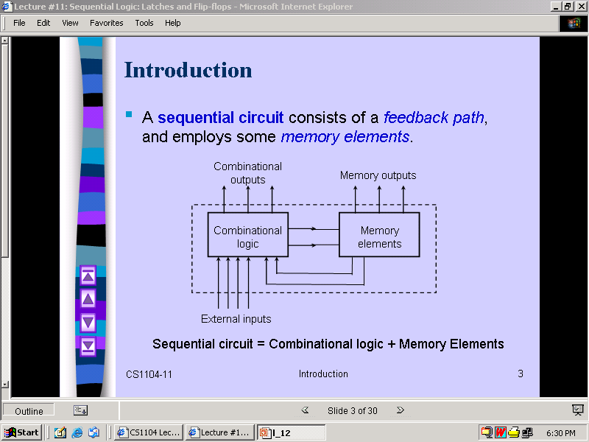

Slide 3
Sequential Logic
Combinational Logic
Output depends only on current input
Sequential Logic
Output depends not only on current input but also on past input values
Need some type of memory to remember the past input values

Slide 4
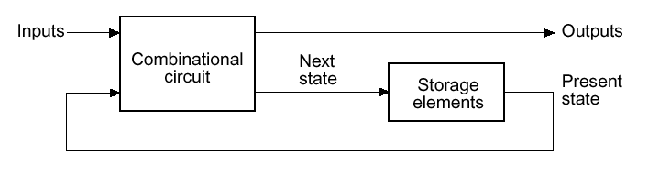
Circuits that we
have learned
so far
Information Storing
Circuits
Timed “States”

Slide 5
Types of Sequential Ckt.
Sequential ckt. can be classified into two types
  Synchronous
  Asynchronous

Slide 6
Synchronous sequential Circuit
A system whose behavior can be defined from the knowledge of its signal at discrete instant of time.
Practical Synchronous sequential logic system use fixed amplitudes such as voltage levels for the binary signals.
Synchronization is achieved by a timing device called a master clock generator.

Slide 7
Asynchronous sequential circuits
In this Behavior of sequential circuits depends upon the order in which its input signals change and can be affected at any instant of time.
In this type of ckt. Master clock generator is general not required.

Slide 8
Flip-Flop
A flip-flop circuit can maintain a binary state indefinitely(as long as power is delivered to the circuit) until directed by an input signal to switch states.
There are different type of flip flop based on number of input and in the manner in which the input affect the binary state.

Slide 9
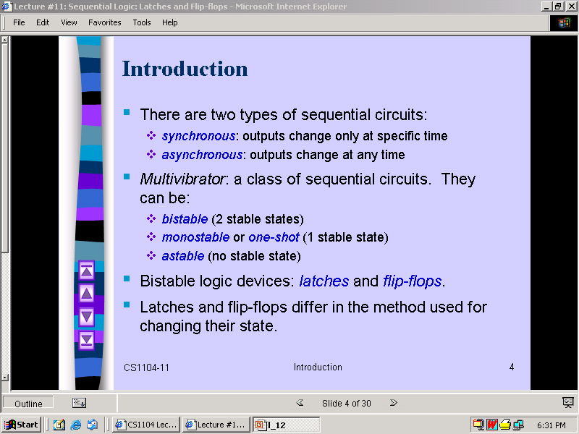

Slide 10
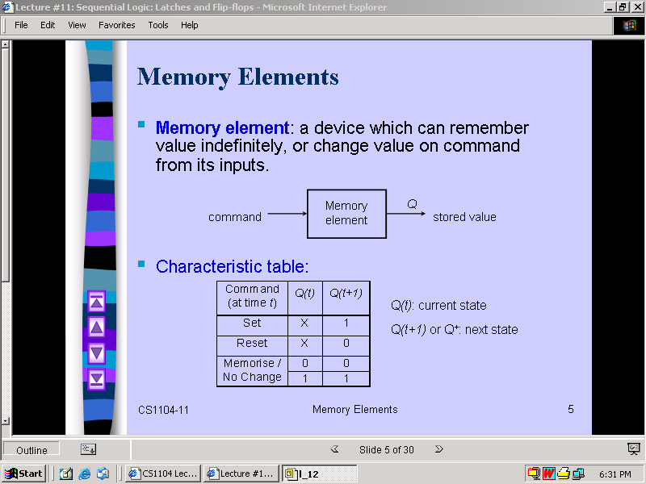

Slide 11
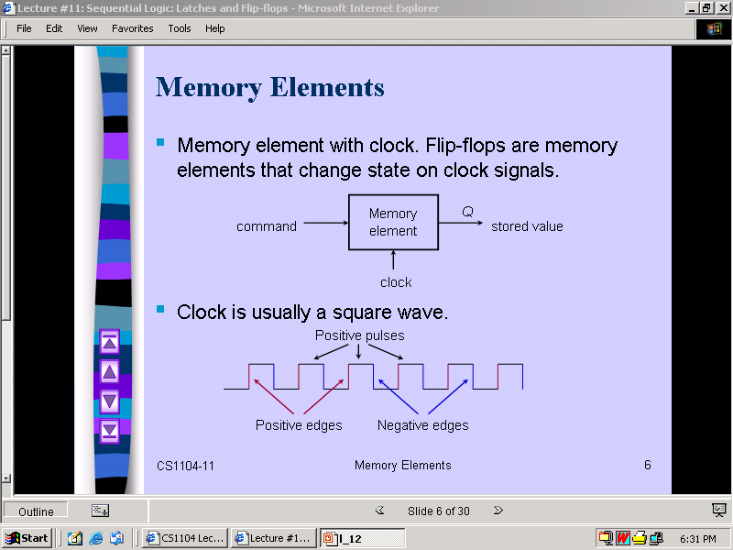

Slide 12
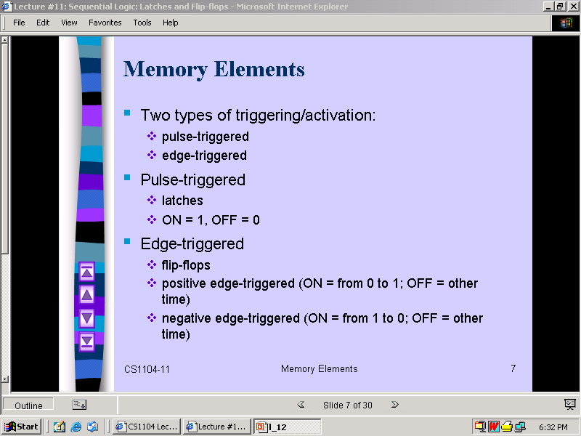

Slide 13
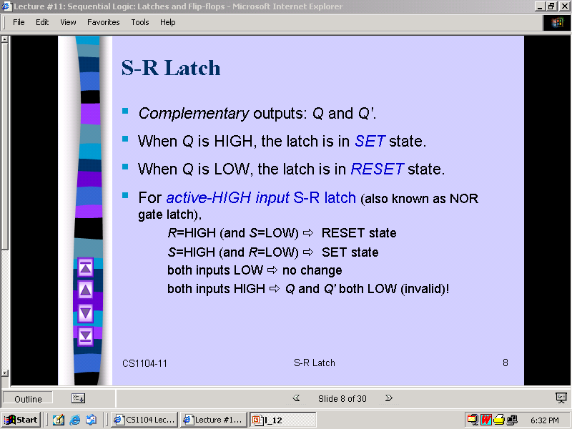

Slide 14
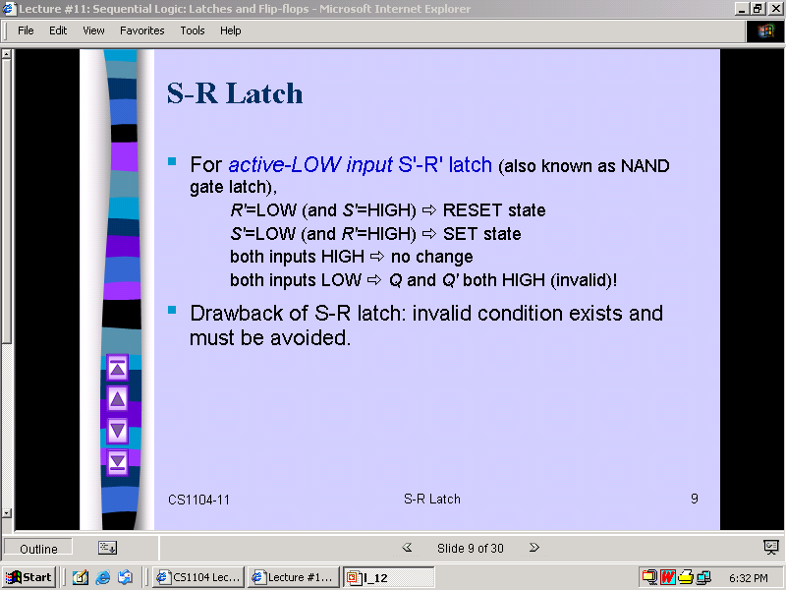

Slide 15
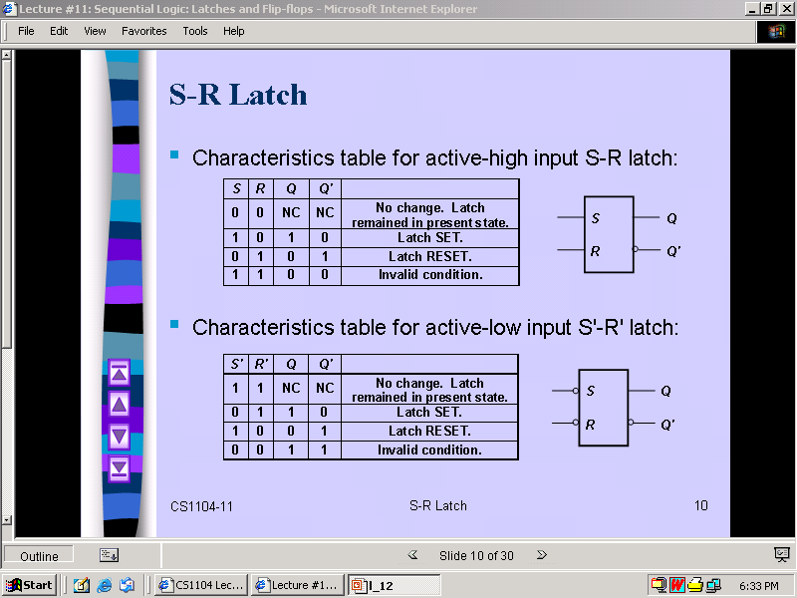

Slide 16
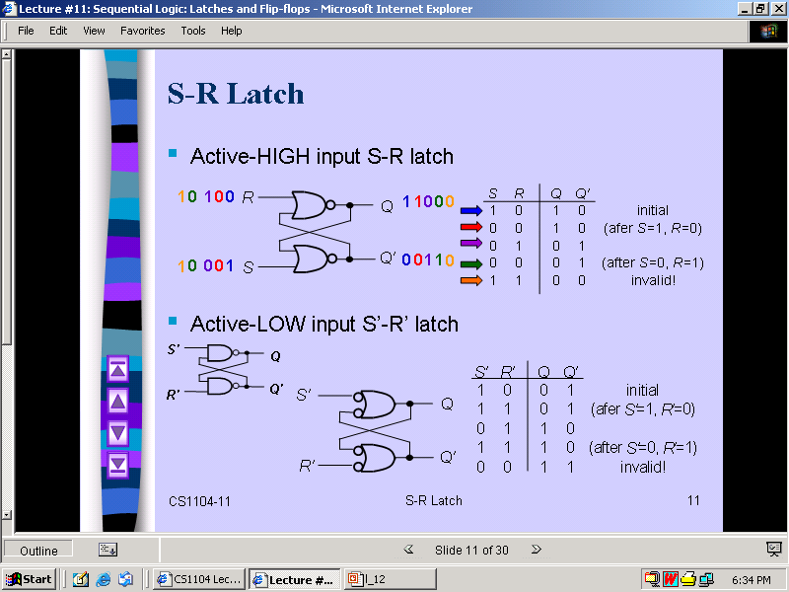

Slide 17
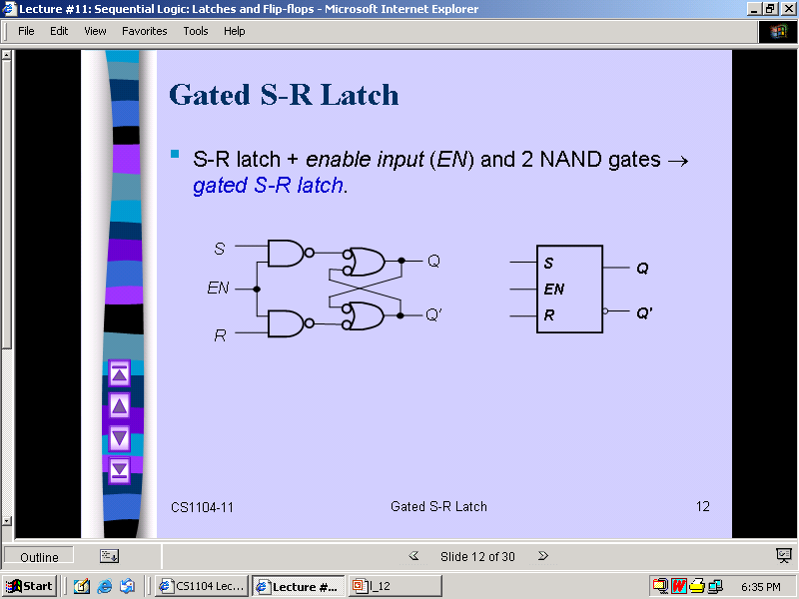

Slide 18
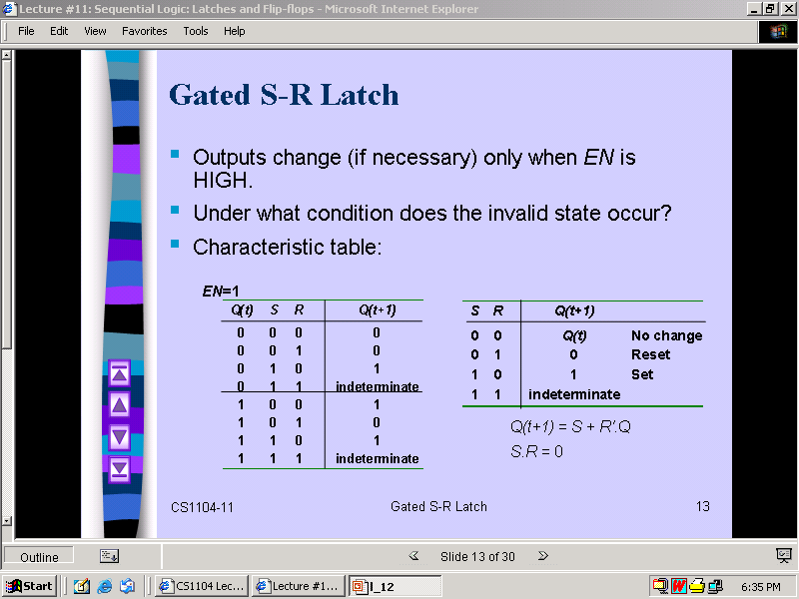

Slide 19
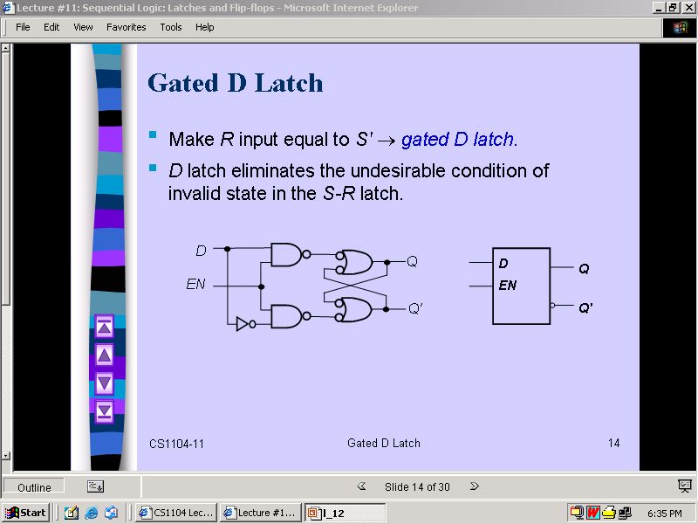

Slide 20
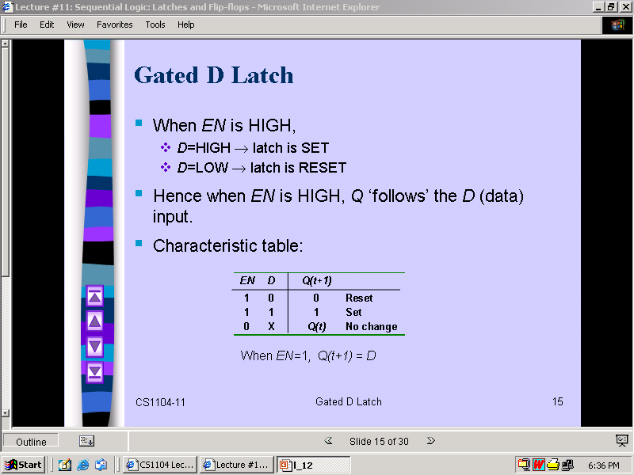

Slide 21
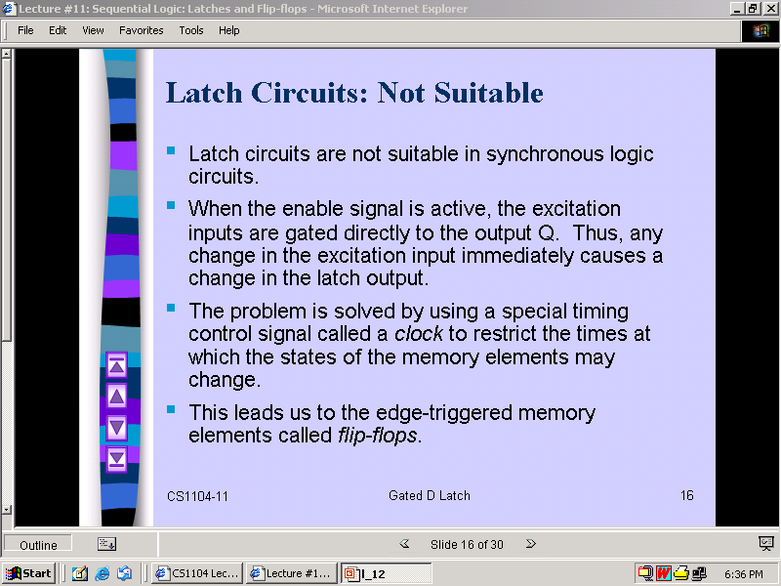

Slide 22
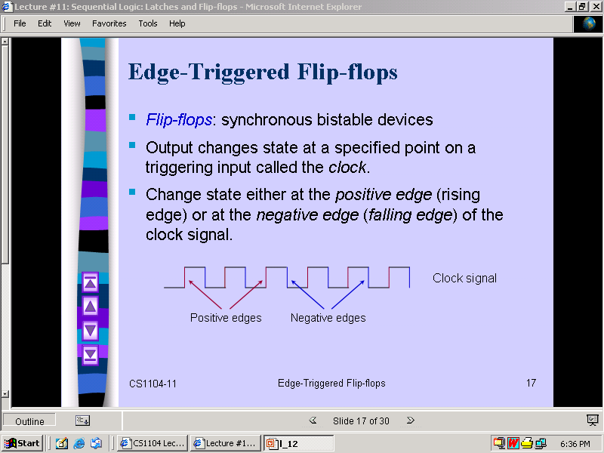

Slide 23
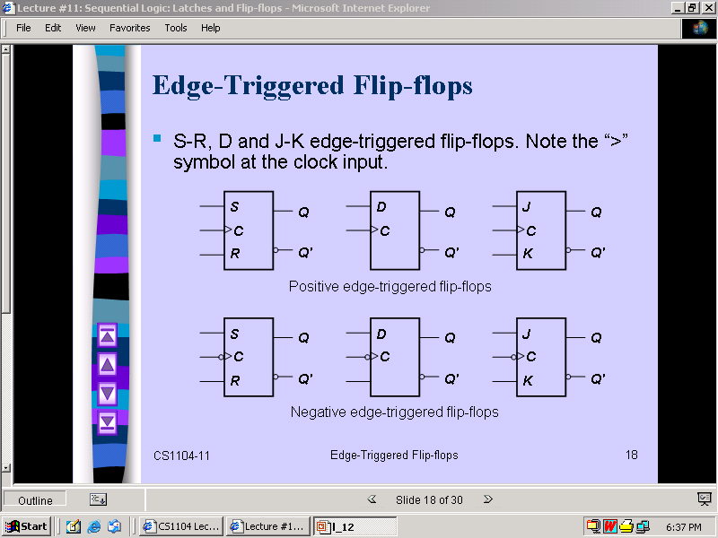

Slide 24
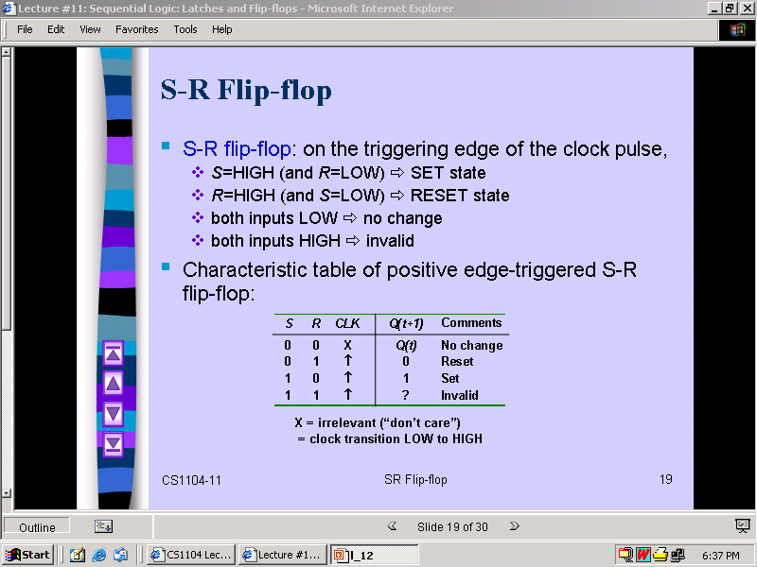

Slide 25
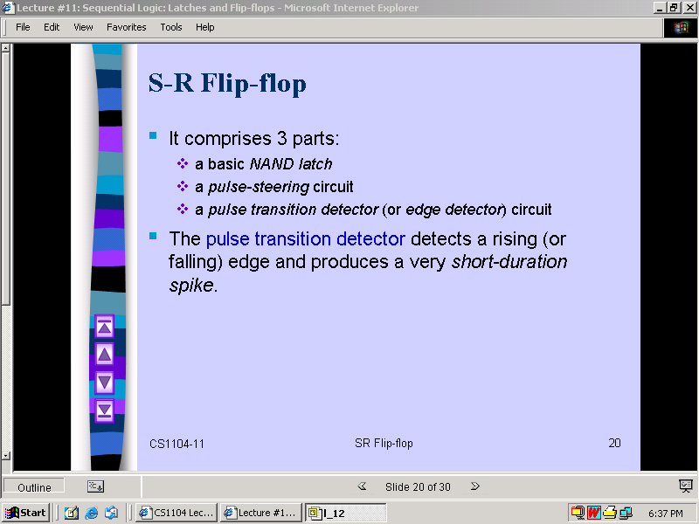

Slide 26
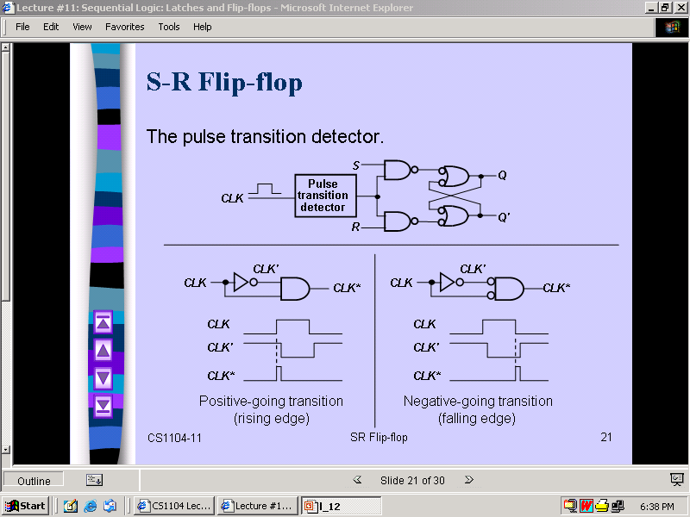

Slide 27
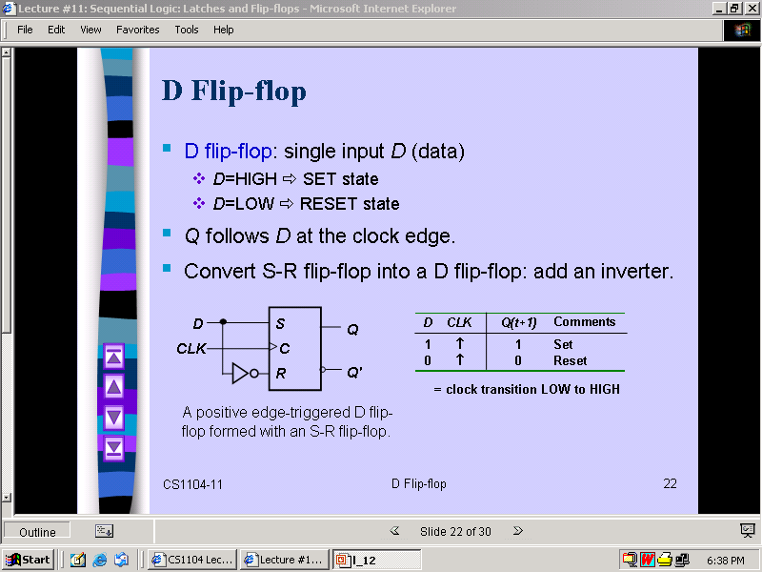

Slide 28
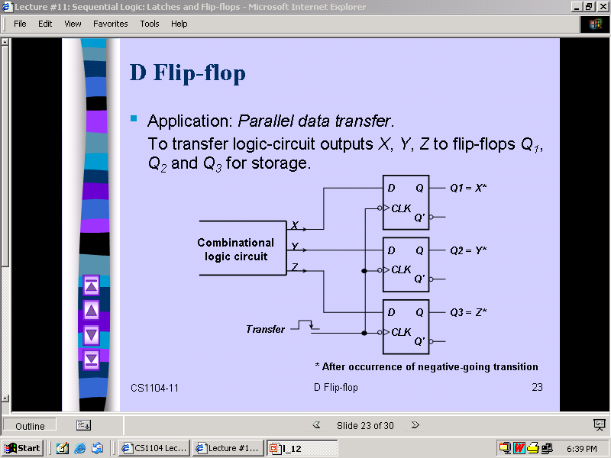

Slide 29
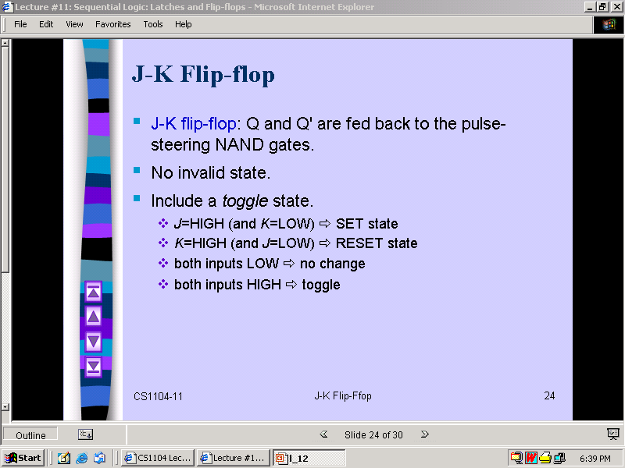

Slide 30
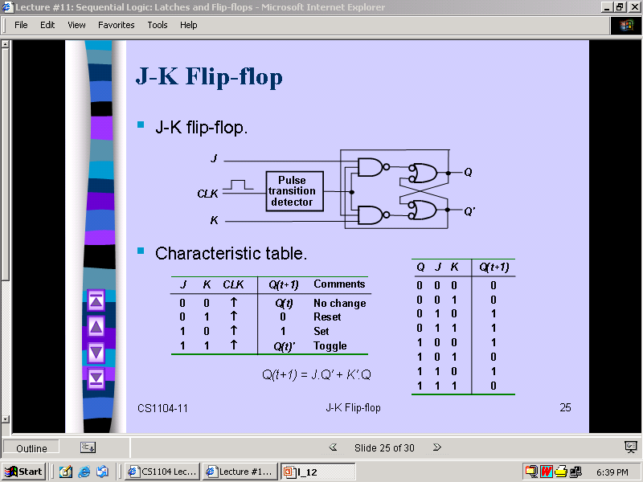

Slide 31
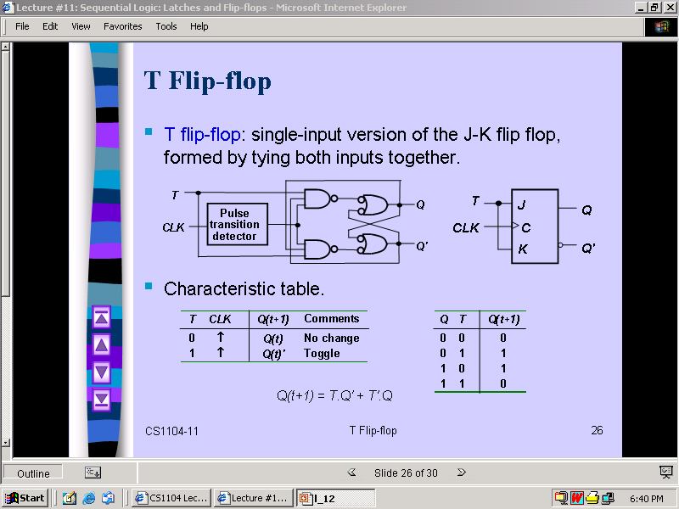

Slide 32
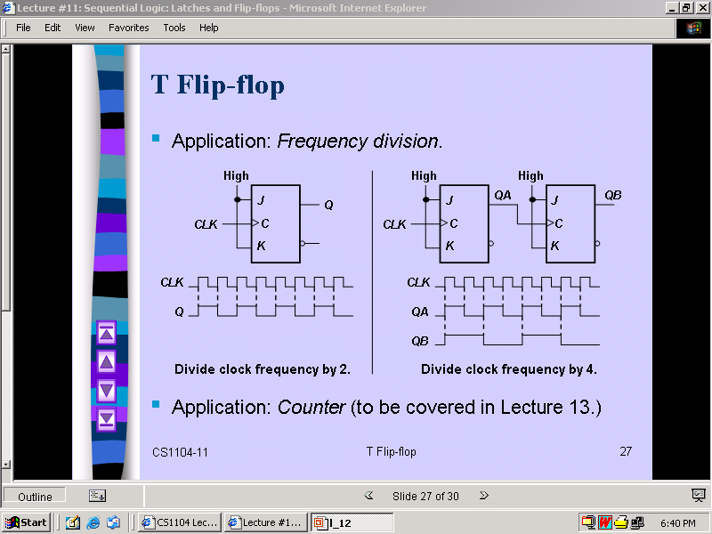

Slide 33
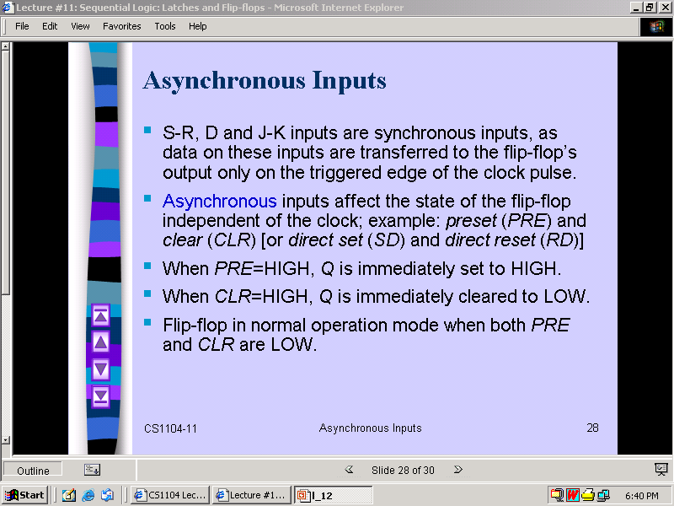

Slide 34
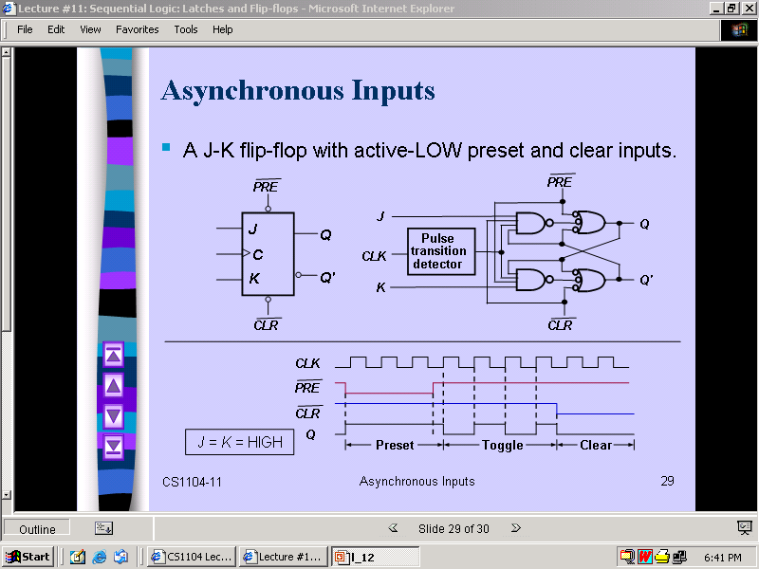

Slide 35


